Slide 1
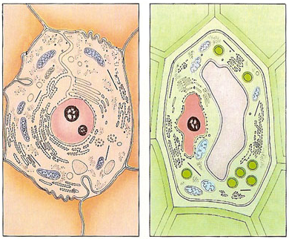
Cell Membrane (Transport) Notes
Cell Membrane and Cell Wall:
ALL cells have a cell membrane made of proteins and lipids
protein channel
Cell Membrane
Layer 1
Layer 2
SOME cells have cell membranes and cell walls – ex: plants, fungi and bacteria
lipid bilayer
protein pump
Cell Membrane
Cell Wall

Slide 2
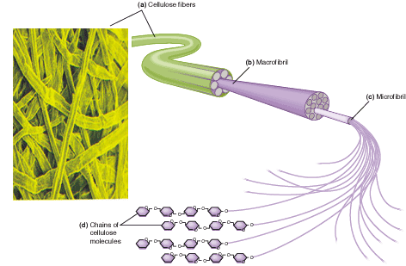
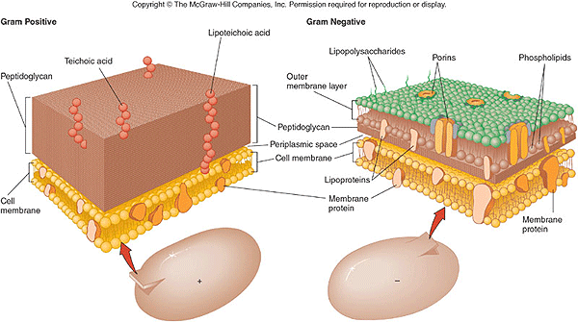
Plant cells have a cell wall made of cellulose – that cellulose is fiber in our diet
Bacteria and fungi also have cell walls, but they do not contain cellulose
Cell membranes and cell walls are porous allowing water, carbon dioxide, oxygen and nutrients to pass through easily

Slide 3
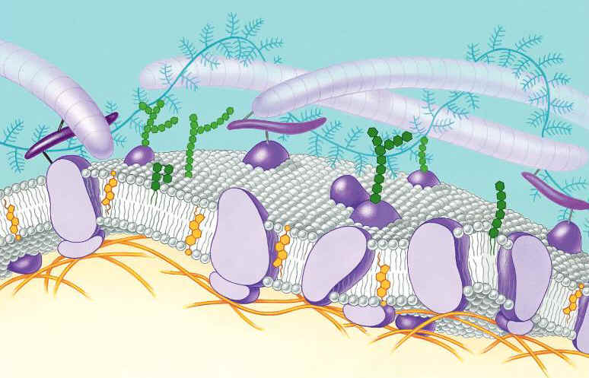
Function of the Cell Membrane:
Cell membrane separates the components of a cell from its environment—surrounds the cell
“Gatekeeper” of the cell—regulates the flow of materials into and out of cell—selectively permeable
Cell membrane helps cells maintain homeostasis—stable internal balance

Slide 4
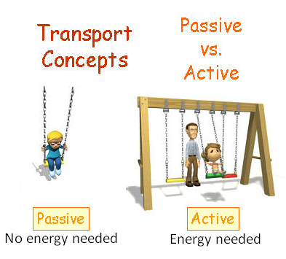
Passive Transport
A process that does not require energy to move molecules from a HIGH to LOW concentration
Diffusion
Facilitated Diffusion
Osmosis

Slide 5
Diffusion is the movement of small particles across a selectively permeable membrane like the cell membrane until equilibrium is reached.
These particles move from an area of high concentration to an area of low concentration.
outside of cell
inside of cell

Slide 6
Diffusion
HIGH to LOW concentration

Slide 7
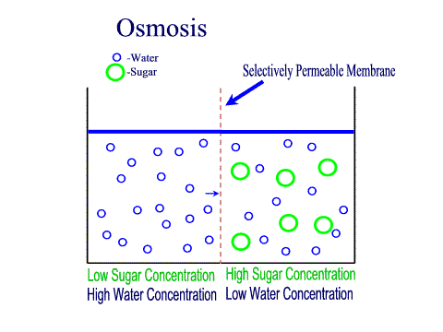
Osmosis is the diffusion of water through a selectively permeable membrane like the cell membrane
Water diffuses across a membrane from an area of high concentration to an area of low concentration.
Semi-permeable membrane is permeable to water, but not to sugar

Slide 8
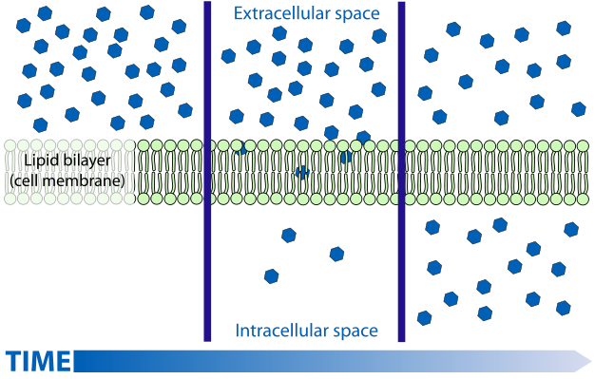

Slide 9
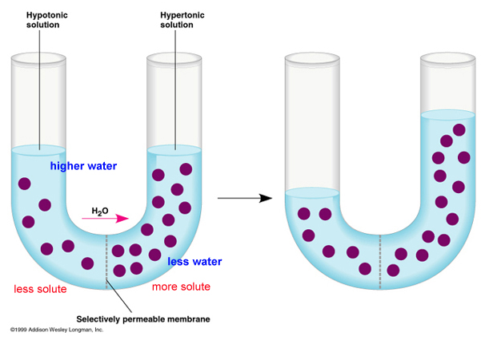

Slide 10
Facilitated Diffusion is the movement of larger molecules like glucose through the cell membrane – larger molecules must be “helped”
Proteins in the cell membrane form channels for large molecules to pass through
Proteins that form channels (pores) are called protein channels
Glucose molecules
outside of cell
inside of cell

Slide 11
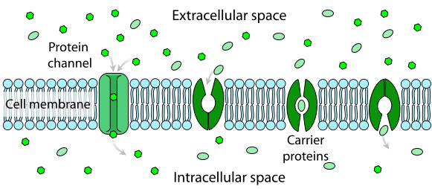
Click

Slide 12
Hypertonic Solutions: contain a high concentration of solute relative to another solution (e.g. the cell's cytoplasm). When a cell is placed in a hypertonic solution, the water diffuses out of the cell, causing the cell to shrivel.
Hypotonic Solutions: contain a low concentration of solute relative to another solution (e.g. the cell's cytoplasm). When a cell is placed in a hypotonic solution, the water diffuses into the cell, causing the cell to swell and possibly explode.
Isotonic Solutions: contain the same concentration of solute as another solution (e.g. the cell's cytoplasm). When a cell is placed in an isotonic solution, the water diffuses into and out of the cell at the same rate. The fluid that surrounds the body cells is isotonic.

Slide 13
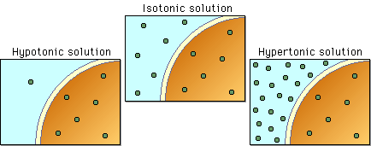

Slide 14
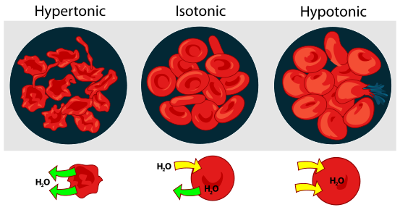
Interactive Red Blood Cell
Click

Slide 15
Active Transport
Active transport is the movement of molecules from LOW to HIGH concentration.
Energy is required as molecules must be pumped against the concentration gradient.
Proteins that work as pumps are called protein pumps.
Ex: Body cells must pump carbon dioxide out into the surrounding blood vessels to be carried to the lungs for exhale. Blood vessels are high in carbon dioxide compared to the cells, so energy is required to move the carbon dioxide across the cell membrane from LOW to HIGH concentration.
outside of cell
Carbon Dioxide molecules
inside of cell

Slide 16
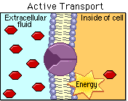

Slide 17
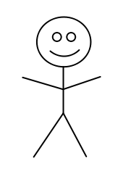
ANALOGY:
ENERGY NEEDED:
Active Transport
NO ENERGY NEEDED:
Diffusion
Osmosis
Facilitated Diffusion

Slide 18
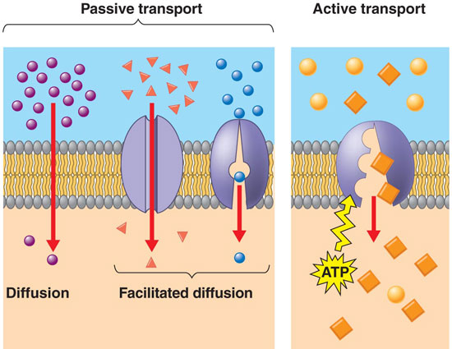

Slide 19
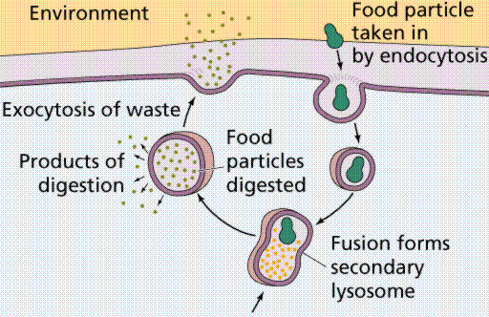
Endocytosis and Exocytosis is the mechanism by which very large molecules (such as food and wastes) get into and out of the cell
Food is moved into the cell by Endocytosis
Wastes are moved out of the cell by Exocytosis

Slide 20
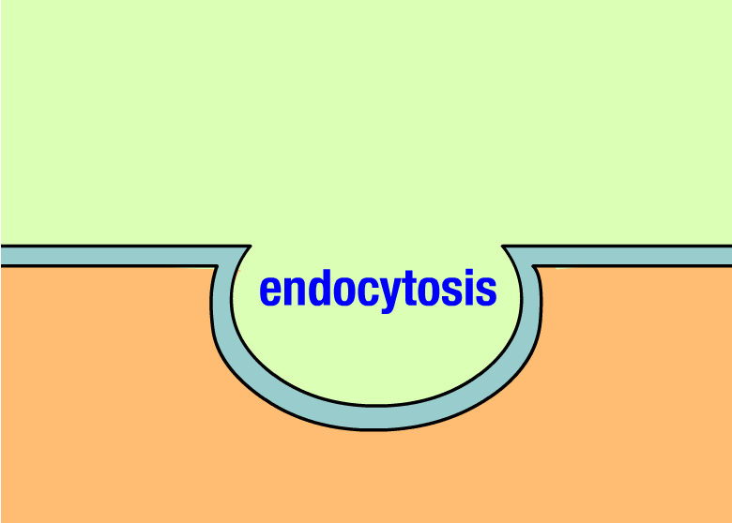

Slide 21
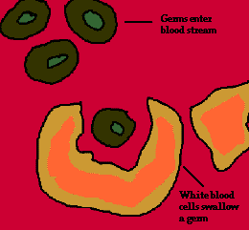
Ex: White Blood Cells, which are part of the immune system, surround and engulf bacteria by endocytosis.

Slide 22
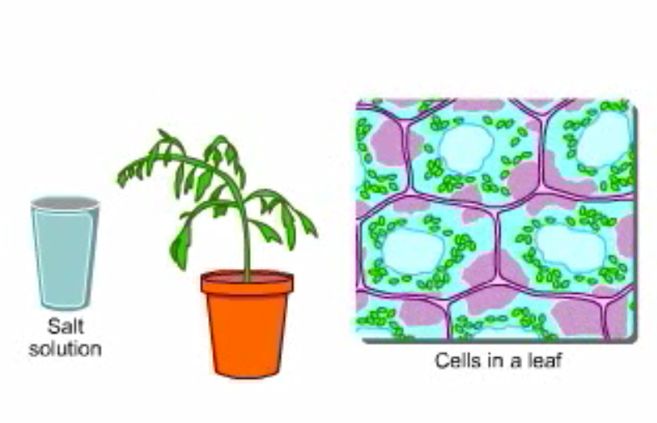
Osmosis—Elodea Leaf

